Slide 1


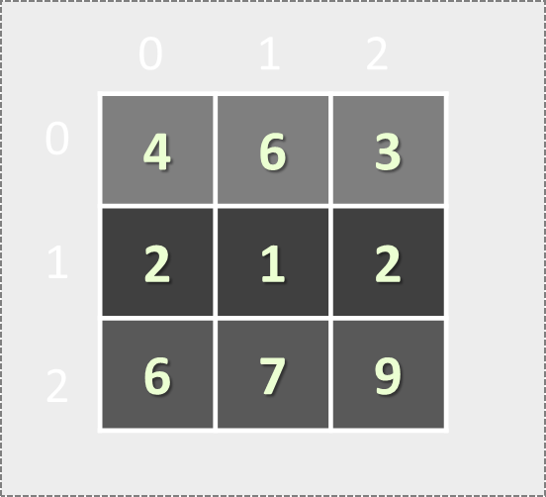

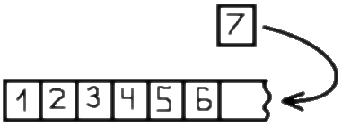
Lists and Matrices
Lists: Variable-Size Arrays
Matrices: Arrays of Arrays (Tables)
Lists and Matrices
SoftUni Team
Technical Trainers
Software University
http://softuni.bg

Slide 2


Table of Contents
Lists and the List<T> Type
Variable-Size Arrays
Sorting Lists and Arrays
Lists – Problems
Multi-Dimensional Arrays
Matrices: Reading, Printing and Processing
Matrices – Problems

Slide 3
Questions?
sli.do #1282

Slide 4
Lists of Elements
Variable-Size Arrays: List<T>

Slide 5

Lists
In C# arrays have fixed length
Cannot add / remove / insert elements
Lists are like resizable arrays
Support add / remove / insert of elements
List<T> defines a list of certain type T
T is the type of the list, e.g. string, int, DateTime, …
List<int> numbers = new List<int>();
numbers.Add(5);
Console.WriteLine(numbers[0]); // 5

Slide 6
List<T> – Example
Use System.Collections.Generic to access collection classes like List<T>
using System.Collections.Generic;
…
List<string> names = new List<string>() { "Peter",
"Maria", "Katya", "Todor" }; // Peter, Maria, Katya, Todor
names.Add("Nakov"); // Peter, Maria, Katya, Todor, Nakov
names.RemoveAt(0); // Maria, Katya, Todor, Nakov
names.Remove("Todor"); // Maria, Katya, Nakov
names.Insert(2, "Sylvia"); // Maria, Katya, Sylvia, Nakov
names[1] = "Michael"; // Maria, Michael, Sylvia, Nakov
foreach (var name in names)
Console.WriteLine(name);

Slide 7
Problem: Remove Negatives and Reverse
Read a list of integers, remove all negative numbers from it and print the list in reversed order:
10 -5 7 9 -33 50
50 9 7 10
7 -2 -10 1
1 7
1 2 3
3 2 1
-1 -2 -3
empty
Check your solution here: https://judge.softuni.bg/Contests/Practice/Index/173#0

Slide 8
Solution: Remove Negatives and Reverse
using System.Collections.Generic;
using System.Linq;
…
List<int> list = Console.ReadLine()
.Split(' ').Select(int.Parse).ToList();
List<int> result = new List<int>();
foreach (var item in list)
if (item >= 0) result.Add(item);
result.Reverse();
if (result.Count > 0)
Console.WriteLine(string.Join(" ", result));
else Console.WriteLine("empty");
Read a list from the console
Check your solution here: https://judge.softuni.bg/Contests/Practice/Index/173#0

Slide 9
Problem: Append Lists
Write a program to append several lists of numbers
Lists are separated by |
Values are separated by spaces (one or several)
Order the lists from last to first, and their values from left to right
1 2 3 |4 5 6 | 7 8
7 8 4 5 6 1 2 3
7 | 4 5|1 0| 2 5 |3
3 2 5 1 0 4 5 7
1| 4 5 6 7 | 8 9
8 9 4 5 6 7 1
Check your solution here: https://judge.softuni.bg/Contests/Practice/Index/173#1

Slide 10
Solution: Append Lists
var lists = Console.ReadLine().Split('|');
var result = new List<string>();
for (int i = lists.Length - 1; i >= 0; i--)
{
var list = lists[i].Split(' ');
foreach (var item in list)
result.Add(item);
// TODO: skip empty items
}
Console.WriteLine(string.Join(" ", result));
Check your solution here: https://judge.softuni.bg/Contests/Practice/Index/173#1

Slide 11
Problem: Sum Adjacent Equal Numbers
Write a program to sum all adjacent equal numbers in a list of decimal numbers, starting from left to right
After two numbers are summed, the obtained result could be equal to some of its neighbors and should be summed as well
3 3 6 1
6 6 1
12 1
0.1 0.1 5 -5
0.2 5 -5
8 2 2 4 8 16
8 4 4 8 16
8 8 8 16
16 8 16
5 4 2 1 1 4
5 4 2 2 4
5 4 4 4
5 8 4
Check your solution here: https://judge.softuni.bg/Contests/Practice/Index/173#2

Slide 12
Solution: Sum Adjacent Equal Numbers
var nums = Console.ReadLine().Split(' ')
.Select(double.Parse).ToList();
int pos = 0;
while (pos < nums.Count - 1)
if (nums[pos] == nums[pos + 1])
{
nums.RemoveAt(pos);
nums[pos] = 2 * nums[pos];
pos--; // TODO: ensure the position is non-negative
}
else pos++;
Console.WriteLine(string.Join(" ", nums));
Replace equal adjacent numbers with their sum; move one position back
Check your solution here: https://judge.softuni.bg/Contests/Practice/Index/173#2

Slide 13
Problem: Split by Word Casing
Read a text, split it into words and distribute them into 3 lists:
Lower-case words; mixed-case words; upper-case words
Use the following separators: , ; : . ! ( ) " ' / \ [ ] space
Learn programming at SoftUni: Java, PHP, JS, HTML 5, CSS, Web, C#, SQL, databases, AJAX, etc.
Non-letters are considered mixed-case
Lower-case: programming, at, databases, etc
Mixed-case: Learn, SoftUni, Java, 5, Web, C#
Upper-case: PHP, JS, HTML, CSS, SQL, AJAX
Check your solution here: https://judge.softuni.bg/Contests/Practice/Index/173#3

Slide 14
Solution: Split by Word Casing
var separators new char[]
{ ',', ';', ':', '.', '!', ' ' }; // TODO: add the others
var words = Console.ReadLine().Split(separators,
StringSplitOptions.RemoveEmptyEntries).ToList();
var lowerCaseWords = new List<string>();
var mixedCaseWords = new List<string>();
var upperCaseWords = new List<string>();
foreach (var word in words)
{ // TODO: process each word }
Console.WriteLine("Lower-case: {0}",
string.Join(", ", lowerCaseWords));
// TODO: print the other lists
Check your solution here: https://judge.softuni.bg/Contests/Practice/Index/173#3

Slide 15
Solution: Split by Word Casing (2)
// Process each word
var lowerCaseChars = 0;
var upperCaseChars = 0;
foreach (char letter in word)
if (char.IsLower(letter)) lowerCaseChars++;
else if (char.IsUpper(letter)) upperCaseChars++;
if (lowerCaseChars == word.Length)
lowerCaseWords.Add(word);
else if (upperCaseChars == word.Length)
upperCaseWords.Add(word);
else mixedCaseWords.Add(word);
Check your solution here: https://judge.softuni.bg/Contests/Practice/Index/173#3

Slide 16


Working with Lists
Live Exercises in Class (Lab)

Slide 17


Sorting Lists and Arrays

Slide 18
Sorting Lists and Arrays
Sorting a list == reorder its elements incrementally
List items should be comparable, e.g. numbers, strings, dates, …
var names = new List<string>() {
"Nakov", "Angel", "Ivan", "Atanas", "Boris" };
names.Sort();
Console.WriteLine(string.Join(", ", names));
// Angel, Atanas, Boris, Ivan, Nakov
names.Sort((a, b) => b.CompareTo(a));
Console.WriteLine(string.Join(", ", names));
// Nakov, Ivan, Boris, Atanas, Angel
Sort in natural order (ascending)
Sort in descending order

Slide 19
Problem: Sort Numbers
Read a list of decimal numbers and sort them
8 2 7 3
2 <= 3 <= 7 <= 8
1 1
1 <= 1
2 4 -9
-9 <= 2 <= 4
1 -0.5
-0.5 <= 1
var nums = Console.ReadLine().Split(' ')
.Select(double.Parse).ToList();
nums.Sort();
Console.WriteLine(string.Join(" <= ", nums));
Check your solution here: https://judge.softuni.bg/Contests/Practice/Index/173#4

Slide 20
Problem: Square Numbers
Read a list of integers and print all square numbers in the list in descending order
A "square number" s is a square of some other integer: s = x * x
3 16 4 5 6 8 9
16 9 4
var squares = new List<int>();
foreach (var num in nums)
if (√num == (int)√num) squares.Add(num);
// TODO: sort squares descending and print them
Check your solution here: https://judge.softuni.bg/Contests/Practice/Index/173#5

Slide 21
Problem: Count Numbers
Read a list of integers in range [0…1000] and print them in ascending order along with their number of occurrences
8 2 2 8 2 2 3 7
10 8 8 10 10
0 5 0 0 1 0
2 -> 4
3 -> 1
7 -> 1
8 -> 2
8 -> 2
10 -> 3
0 -> 4
1 -> 1
5 -> 1
Check your solution here: https://judge.softuni.bg/Contests/Practice/Index/173#6

Slide 22
Solution: Count Numbers (Simple)
var nums = Console.ReadLine().Split(' ')
.Select(int.Parse).ToList();
var counts =
new int[nums.Max() + 1];
foreach (var num in nums)
counts[num]++;
for (int i = 0; i < counts.Length; i++)
if (counts[i] > 0)
Console.WriteLine($"{i} -> {counts[i]}");
counts[num] holds how many times num occurs in the list
Check your solution here: https://judge.softuni.bg/Contests/Practice/Index/173#6

Slide 23
Solution: Count Numbers (by Sorting)
var nums = Console.ReadLine().Split(' ')
.Select(int.Parse).ToList();
nums.Sort();
var pos = 0;
while (pos < nums.Count)
{
int num = nums[pos], count = 1;
while (pos + count < nums.Count &&
nums[pos + count] == num)
count++;
pos = pos + count;
Console.WriteLine($"{num} -> {count}");
}
Sort the numbers
Count how times num occurs starting from position pos
Check your solution here: https://judge.softuni.bg/Contests/Practice/Index/173#6

Slide 24
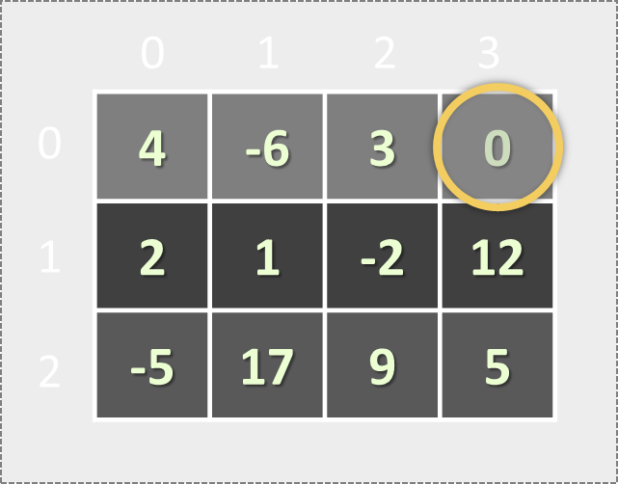
Matrices (Tables)
Nested Structures

Slide 25
Matrices
A matrix is a table of values
We can create matrices by nesting simple structures
Arrays of arrays
List of lists
0 1 2 3
0
1
2
3
4 | -6 | 3 | 0
Element matrix[0][2] at row 0, column 2
2 | 1 | -2
Matrix of 4 rows
-5 | 17
7 | 3 | -9 | 12

Slide 26
Problem: Build a Matrix of Letters
Build and print a matrix of capital Latin letters of size rows x cols like at the examples below:
2
2
A B C D
E F G H
I J K L
M N O P
Q R S T
U V W X
3
7
6
4
A B
C D
A B C D E F G
H I J K L M N
O P Q R S T U
Check your solution here: https://judge.softuni.bg/Contests/Practice/Index/173#7

Slide 27
Solution: Build a Matrix of Letters
Build the matrix of letters of size rows x cols (e.g. 6 rows x 4 cells):
int rows = int.Parse(Console.ReadLine());
int cols = int.Parse(Console.ReadLine());
var matrix = new char[rows][];
char letter = 'A';
for (int row = 0; row < rows; row++)
{
matrix[row] = new char[cols];
for (int col = 0; col < cols; col++)
matrix[row][col] = letter++;
}
0 1 2 3
0
1
2
3
4
5
A | B | C | D
E | F | G | H
I | J | K | L
M | N | O | P
Q | R | S | T
U | V | W | X
Check your solution here: https://judge.softuni.bg/Contests/Practice/Index/173#7

Slide 28
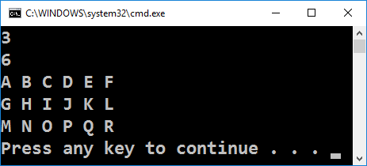
Solution: Print the Matrix
Print the matrix of size rows x cols:
Just print the array stored in each row
for (int row = 0; row < rows; row++)
Console.WriteLine(string.Join(" ", matrix[row]));
Check your solution here: https://judge.softuni.bg/Contests/Practice/Index/173#7

Slide 29
Reading Matrices from the Console
First read the number of rows rows and columns cols
Allocate the matrix as array of rows arrays
Read each matrix row like normal array of cells
int rows = int.Parse(Console.ReadLine());
int cols = int.Parse(Console.ReadLine());
var matrix = new int[rows][];
for (int row = 0; row < rows; row++)
matrix[row] = Console.ReadLine()
.Split(' ').Select(int.Parse).ToArray();

Slide 30
Problem: Rotate a Matrix
Write a program to read a matrix of words (space separated) and rotate it on the right as shown in the examples:
3
4
A B C D
E F G H
I J K L
I E A
J F B
K G C
L H D
3
3
Hi PHP Java
C# SQL JSON
HTML CSS JS
HTML C# Hi
CSS SQL PHP
JS JSON Java
Matrix of 3 rows * 4 columns
Rotated matrix of 4 rows * 3 columns
Check your solution here: https://judge.softuni.bg/Contests/Practice/Index/173#8

Slide 31
Solution: Rotate a Matrix
int rows = int.Parse(Console.ReadLine());
int cols = int.Parse(Console.ReadLine());
var matrix = // TODO: read the matrix[][]
// Print the rotated matrix row by row
for (int col = 0; col < cols; col++)
{
for (int row = rows - 1; row >= 0; row--)
Console.Write(matrix[row][col] + " ");
Console.WriteLine();
}
Check your solution here: https://judge.softuni.bg/Contests/Practice/Index/173#8

Slide 32
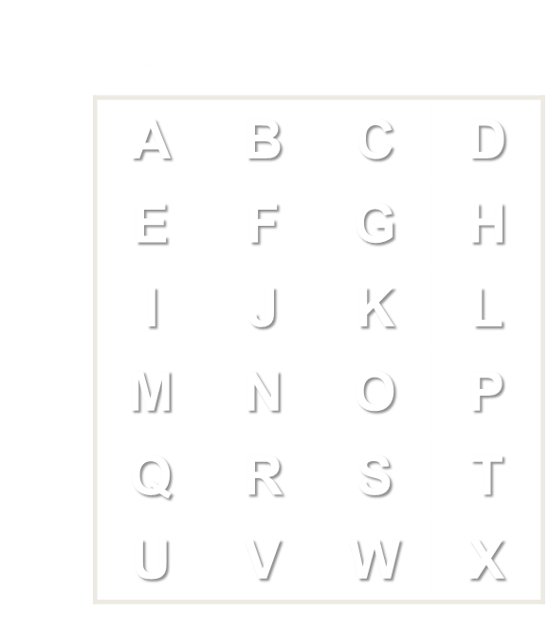
Matrices
Live Exercises in Class (Lab)

Slide 33

Summary
Lists hold resizable arrays of elements
Can add / remove / change elements
Creating a list and adding an element:
Matrices hold a table of elements (array of arrays)
List<int> numbers = new List<int>();
numbers.Add(5);
var matrix = new int[rows][];
matrix[0] = new int[10];
matrix[0][0] = 5;

Slide 34








Lists and Matrices
https://softuni.bg/courses/programming-fundamentals

Slide 35
License
This course (slides, examples, demos, videos, homework, etc.) is licensed under the "Creative Commons Attribution-NonCommercial-ShareAlike 4.0 International" license
Attribution: this work may contain portions from
"Fundamentals of Computer Programming with C#" book by Svetlin Nakov & Co. under CC-BY-SA license

Slide 36






Free Trainings @ Software University
Software University Foundation – softuni.org
Software University – High-Quality Education, Profession and Job for Software Developers
softuni.bg
Software University @ Facebook
facebook.com/SoftwareUniversity
Software University @ YouTube
youtube.com/SoftwareUniversity
Software University Forums – forum.softuni.bg

